Slide 1
STA Handbook
Abriella D. Corker

Slide 2
Time Keeping
Always clock in and out for meetings, breaks, and shifts.
Fill out time daily on the punch in card, Harvest, and Workday.
Make sure to fill out weekly on Workday and Harvest
Always notify Suloni on any changes to the schedule

Slide 3
Meetings & Shifts
Do not show up to work if ill, and notify Suloni
Any long term illness preventing availability to work require a doctor’s excuse
Make sure the STA blog is updated for meetings

Slide 4
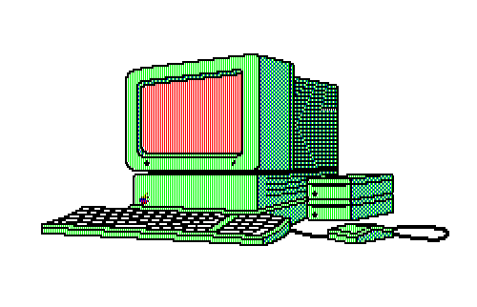
Communication
Always check Slack, Basecamp, and e-mail for messages on projects before starting anything
Post progress on Basecamp for feedback
Always CC Team Leads in emails with clients

Slide 5
Assignments
Do not share or trade assignments without authorization from Suloni
Always post path to server file so others may find files if they need to
If you can not access a folder notify Suloni
Always upload files to server and do not leave them on the desktop
Save all raw un-merged files on STA Volume

Slide 6
Room Rules
Do not lose your key to the room and never lose it
Notify Suloni if key is lost
Do not come to work between 12am and 6am
Careful not to lock yourself out of the Dev. Lab after 4:45 pm
Eat before, no smelly foods in the office
Only staff and clients are allowed in Dev. Lab
Do not download anything on the computer that has not been authorized.

